Slide 1
Speed Bump Detection
Industry Project
Varun Reddy Chanda (S20190010027)
Mentor : Dr. Chandra Shaker
Notes:
Good morning this is Varun, My industry project was Speed bump detection

Slide 2
Contents
Problem statement
Dataset collection
Data preparation
Choosing the DL model
SSD MobileNet V2
Model training
Results
Conclusion and Future scope
Notes:
Comping to the contents of this presentation,
First we will talk about the problem statement,
then I will discuss about the dataset,
then choosing the DL model
We went with ssd mobilenet model
Training the model
Results
And finally conclusion and future scope.

Slide 3
Problem Statement
Detecting the speed bump accurately using deep learning models to enhance driving safety
Notes:
Detecting the speed bump accurately using the machine learning models to enhance driving safely.
Now a days we can see there are many speed bumps on the roads.
Hitting the bump very hard may damage the vehicle and sometimes causes major accidents too.
So, I had implemented a machine learning model using transfer learning to detect the bump in a given image.

Slide 4
Dataset Collection
Dataset : universe roboflow
Contains 50 Images:
35 Training images
15 Validation images
5 Test Images
Notes:
Coming to the dataset
The images of speed bumps are taken from the universe roboflow website.
You find the dataset here.
This dataset consists of a total of 50 images
In which 35 are training images, 15 are validation images and 5 are testing images.

Slide 5
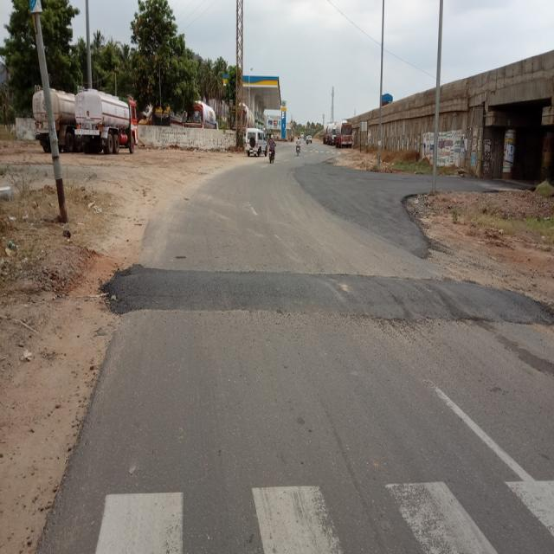
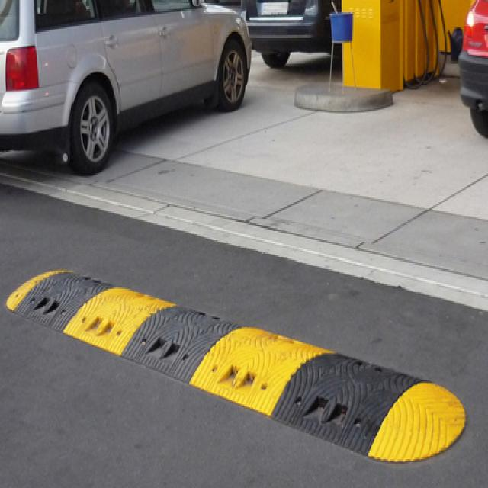
Unmarked Bump Marked Bump
Notes:
In the dataset, there a 2 types of speed bumps. I.e
Unmarked and marked

Slide 6
Data preparation
Need to label the data before training the images on a model.
Label data using:
LabelImg tool ( offline )
makesense.ai
Notes:
Coming to the preparation of dataset,
First we need to label the images before training them on a model.
You can use 2 types of tools:
Label img ( offline tool)
Makesense.ai (online tool)

Slide 7
Choosing the DL model
Many Pre trained Deep Learning models (including detection models) are available in TensorFlow.
Available models: TensorFlow Models
We chose the SDD MobileNet V2 ( Faster prediction speed)
Notes:
Choosing the DL model is very crucial.
There are many pretrained dl models that are available in the tensorflow github page.
You can find the available models through this link.
Here, we chose SSD MobileNet V2 because its test prediction time is low compared to other models.

Slide 8
SSD MobileNet V2
SSD ( Single Shot MultiBox Detector) is a popular object detection algorithm.
MobileNet v2 is a lightweight neural network architecture designed for mobile and embedded devices.
Combining SSD with MobileNet v2 provides an efficient and accurate object detection solution.
Notes:
SSD stands for single shot multibox detector which is a popular object detection algorithm.
MobileNet v2 is a lightweight neural network architecture designed for mobile and embedded systems.
So, we combine both SSD with MobileNet v2 which provides an efficient and accurate object detection solution.

Slide 9
SSD MobileNet V2
SSD MobileNet v2 consists of a base MobileNet v2 network followed by detection layers.
These detection layers predict the bounding box coordinates and class probabilities for different objects, including speed bumps.
Notes:
SSD mobileNet v2 consists of a base mobilenet v2 network followed by detention layers.
These detection layers predict the bounding box coordinates and class probabilities.
In our case the classes are marked bump and unmarked bump.

Slide 10
Model Training
Utilized the pretrained SSD MobileNet v2 model available in TensorFlow.
Adjusted the classes, no.of steps and other parameters according to our problem statement in config file.
Train the model ( Here, Trained for 25,000 steps)
Evaluated the model's performance using metrics such as precision, recall, and mean average precision (mAP).
Notes:
First we will take the pretrained ssd mobilnet model from tensorflow
Then we adjust the classes according to our problem statement.
Train the model for 25,000 steps
Finally evaluate the models performance

Slide 11
Results
Model was able to predict both marked and unmarked speed humps.
Model detected bumps with high accuracy of 95%.
Notes:
Model was able to predict both marked and unmarked speed humps.
Model detected few bumps with high accuracies of more than 95%

Slide 12
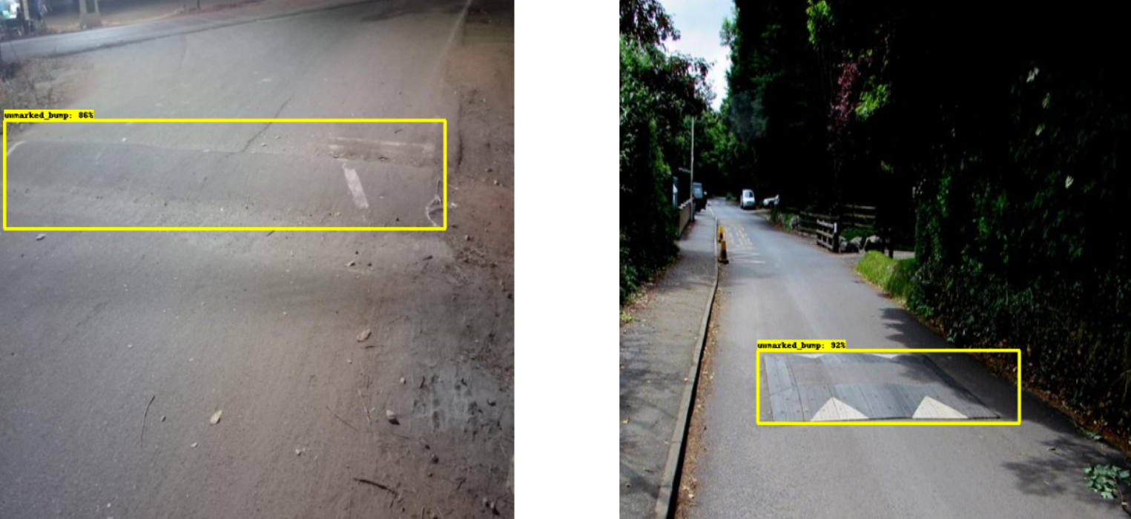
Results
Detectioning unmarked bumps

Slide 13
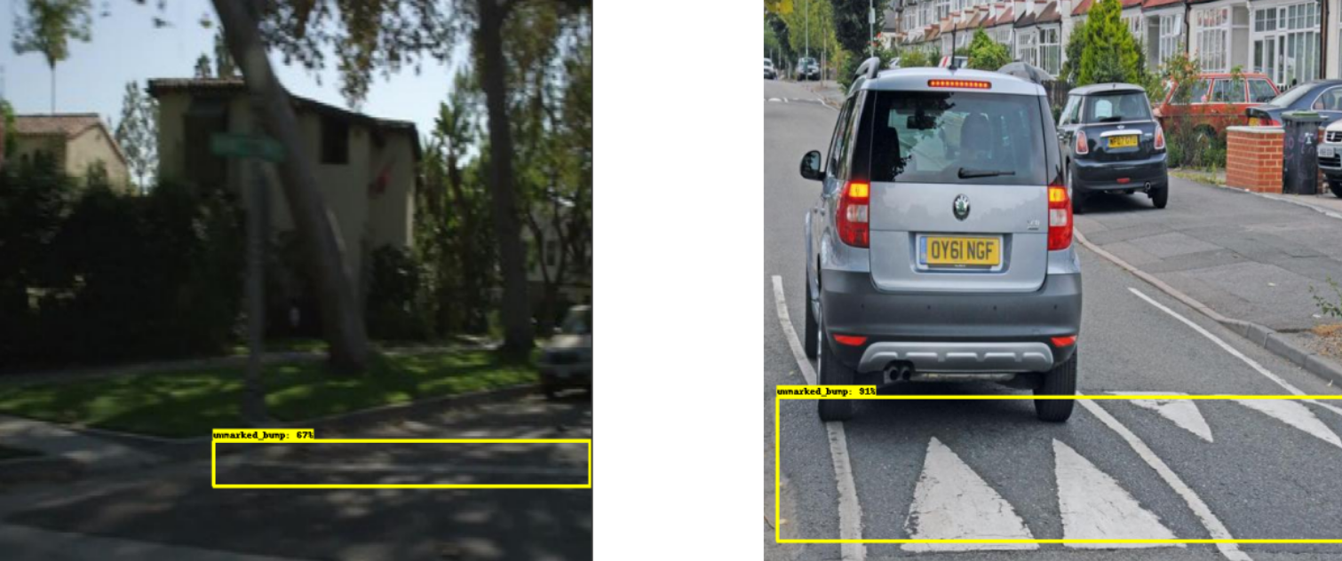
Results
Detectioning unmarked bumps

Slide 14
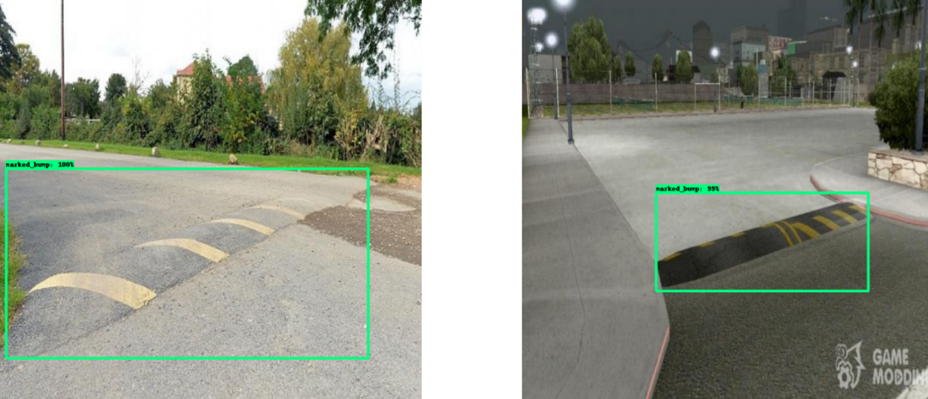
Results
Detectioning marked bumps

Slide 15
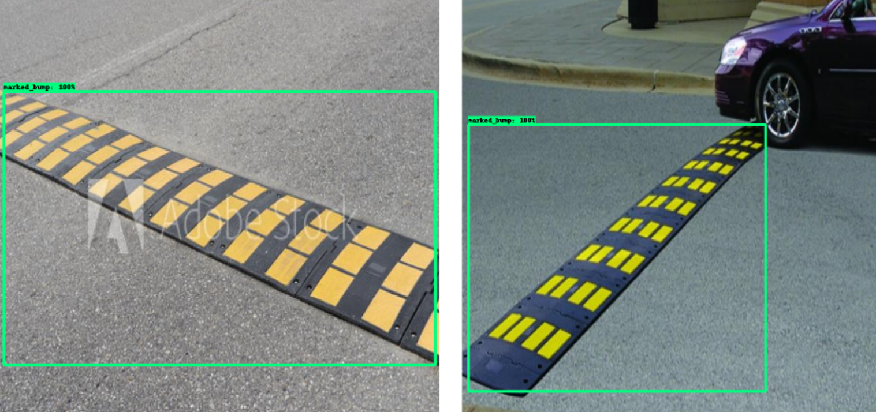
Results
Detectioning marked bumps

Slide 16
Conclusion
SSD MobileNet V2 model trained on marked and unmarked bump classes demonstrated high accuracy and robustness in detecting and localizing speed bumps.
The model successfully distinguished between the two bump classes, which is essential for giving correct alerts to drivers and optimizing car suspension systems.
Results indicate that the SDD MobileNet V2 model is a viable solution for speed bump detection and localization that might be enhanced and expanded for a variety of use cases and applications.

Slide 17
Future Work
In terms of future work, increasing the quantity of the labeled dataset might enhance the model's performance, resulting in more accurate and robust identification of speed bumps.
Furthermore, investigating other deep learning models and architectures may provide additional insight into the detection and localization of speed bumps.
Finally, to ensure the model's robustness in different scenarios, it would be interesting to investigate its performance in different environments and under varying weather conditions.

Slide 18
THANK YOU

